Slide 1
Mastering NT Greek
10. Shocking the Future
By Ted Hildebrandt © 2003
Baker Academic

Slide 2
PAI Verb Paradigm Rap
λύω λύομεν
λύεις λύετε
λύει λύουσι(ν)

Slide 3
2-1-2 Paradigms - Chant this
2 1 2
λόγος γραφή ἱερόν
λόγου γραφῆς ἱεροῦ
λόγῳ γραφῇ ἱερῷ
λόγον γραφήν ἱερόν
λόγοι γραφαί ἱερά
λόγων γραφῶν ἱερῶν
λόγοις γραφαῖς ἱεροῖς
λόγους γραφάς ἱερά

Slide 4
The "is" verb PAI -- εἰμί
εἰμί ἐσμέν
εἶ ἐστέ
ἐστί(ν) εἰσί(ν)

Slide 5
Person Personal Pronoun Chant
Singular Plural
Nom. ἐγώ σύ ἡμεῖς
Gen. μου σου ἡμῶν
Dat. μοι σοι ἡμῖν
Acc. με σε ἡμάς
αὐτός, αὐτη, αὐτό (he, she, it)

Slide 6
Present Middle/Passive Indicative
λύομαι, -ομεθα
-ῃ, -εσθε
-εται, -ονται
I am loosed/am being loosed
I loose myself/am loosing [for myself]

Slide 7
Rapping the Lord’s Prayer
Πάτερ ἡμῶν ὁ ἐν τοῖς οὐρανοῖς
father our the one in heaven
ἁγιασθήτω τὸ ὄνομά σου
make holy name your
ἐλθέτω ἡ βασιλεία σου
let come kingdom your
γενηθήτω τὸ θέλημά σου,
let be will your

Slide 8
English Introduction
Tenses in English
  Present: We go to the mountains.
  Past: We went to the mountains
  Future: We will go to the mountains.
Three types of future: PID
  Predictive: I will go.
  Imperative: You shall go!
  Deliberative rhetorical: Shall we go?

Slide 9
Shape of the Future in Greek
λύσω λύσομεν
I will loose We will loose
λύσεις λύσετε
You will loose You all will loose
λύσει λύσουσι(ν)
S/he/it will loose They will loose
Chant this one

Slide 10
Future Active Indicative Chant
λύσω λύσομεν
λύσεις λύσετε
λύσει λύσουσι(ν)

Slide 11
Future Middle Paradigm
λύσομαι λυσόμεθα
I will loose (for myself) We will loose (for ourselves)
λύσῃ λύσεσθε
You will loose (for yourself) You all will loose (for yourselves)
λύσεται λύσονται
S/he/it will loose (for himself) They will loose (for themselves)
Chant this:
λύσομαι, -ῃ, -εται, -ομεθα, -εσθε, -ονται

Slide 12
Future Middle Chant
λύσομαι, -ομεθα,
-ῃ, -εσθε,
-εται, -ονται

Slide 13
Sigma Addition - 5 Variations
Palatals: κ, γ, or χ + σ = ξ
  ἔχω --- ἕξω I will have
  ἄγω --- ἄξω I will lead, bring
Labials: π, β, or φ + σ = ψ
  βλέπω --- βλέψω I will see
  γράφω --- γράψω I will write
Dentals: τ, δ, or θ + σ = σ
  πείθω --- πείσω I will persuade
Sibilants: σ or ζ + σ = σ
  σῴζω --- σώσω I will save

Slide 14
Sigma Addition--Lemoners
Liquids (Lemoner): λ, μ, ν, or ρ + σ = ˜
The liquid and sigma collapse into a circumflex. Beware of these as they often can be mistaken as a present tense verb.
  μένω ---> μενῶ
  I will remain
  ἀποστέλλω ---> ἀποστελῶ
  I will send

Slide 15
Sigma Shifting Chart
Palatals Dentals
κ, γ, or χ + σ = ξ τ, δ, or θ + σ = σ
Labials Sibilants
π, β, or φ + σ = ψ σ or ζ + σ = σ
Liquids (lemoner)
λ, μ, ν, or ρ + σ = ˜
˜
?

Slide 16
Future of Being: εἰμί
ἔσομαι ἐσόμεθα
I will be We will be
ἔσῃ ἔσεσθε
You will be You all will be
ἔσται ἔσονται
S/he/it will be They will be

Slide 17
Deponent Future
Sometimes verbs are regular in the present but deponent in the future
λαμβάνω λήμψομαι I will take
γινώσκω γνώσομαι I will know

Slide 18
4 Future Bad Boys
ἔρχομαι ἐλεύσομαι I will go/come
λέγω ἐρῶ I will say
γινώσκω γνώσομαι I will know
λαμβάνω λήμψομαι I will take

Slide 19
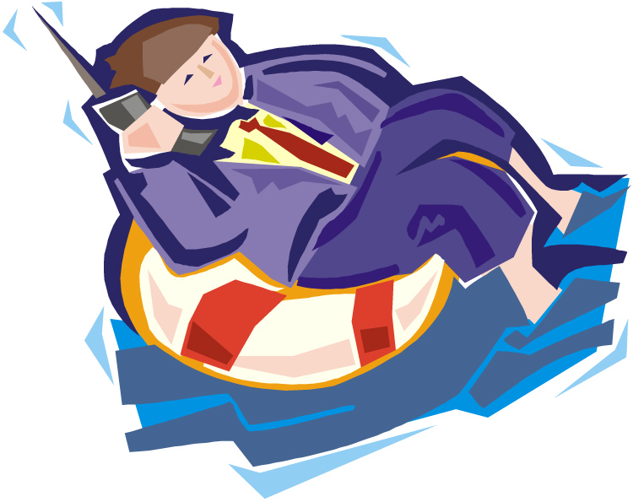
Chapter 10 Vocabulary
ζωή, -ῆς, ἡ
life

Slide 20

Chapter 10 Vocabulary
θάνατος, -ου, ὁ
death

Slide 21

Chapter 10 Vocabulary
κρίνω
I judge

Slide 22
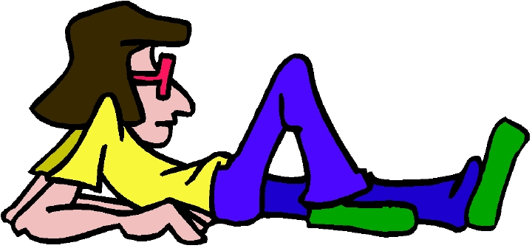
Chapter 10 Vocabulary
μένω
I remain

Slide 23
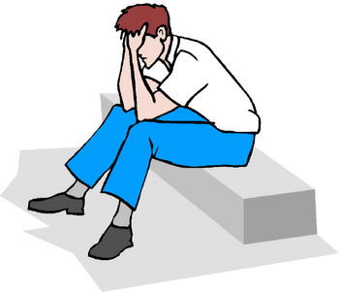
Chapter 10 Vocabulary
μόνος, -η, -ον
only, alone

Slide 24

Chapter 10 Vocabulary
νῦν
now

Slide 25

Chapter 10 Vocabulary
οὐδέ
and not, nor

Slide 26
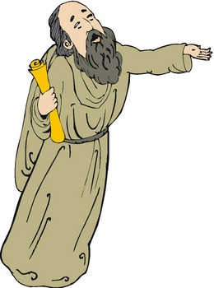
Chapter 10 Vocabulary
Παῦλος
Paul

Slide 27
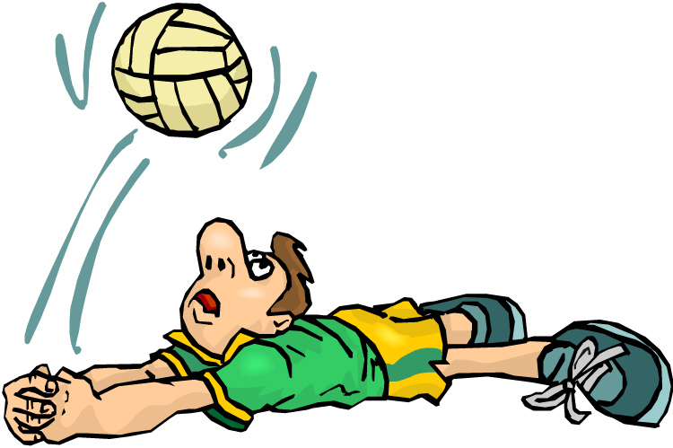
Chapter 10 Vocabulary
σῴζω
I save

Slide 28
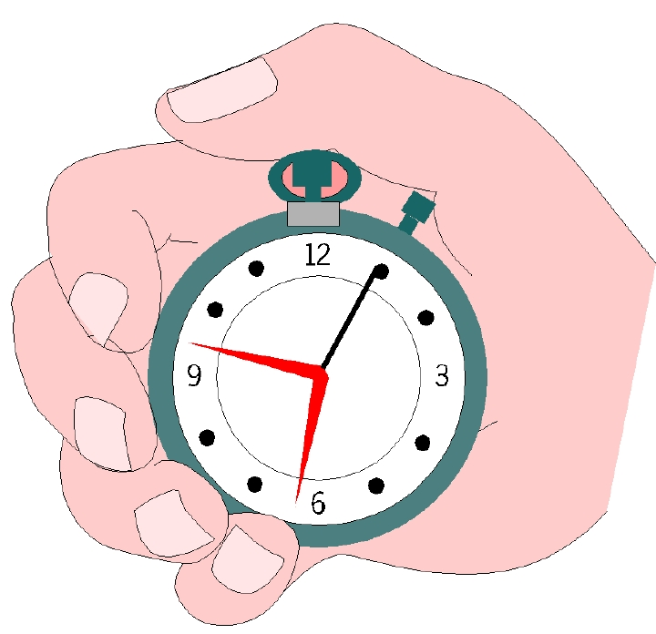
Chapter 10 Vocabulary
τότε
then

Slide 29
Ch. 1 -- Vocabulary
angel, messenger
      ἄγγελος, -ου, ὁ
verily, truly
      ἀμήν
man, humankind
      ἄνθρωπος, -ου, ὁ
I
      ἐγώ
God
      θεός, -οῦ, ὁ

Slide 30
Ch. 1 -- Vocabulary
and, also, even
    καί
heart
    καρδία, -ας, ἡ
I say
    λέγω
prophet
    προφήτης, -ου, ὁ
Christ, Messiah
    Χριστός, -οῦ, ὁ

Slide 31
Ch. 2 -- Vocabulary
brother
      ἀδελφός, -οῦ, ὁ
I hear, obey
      ἀκούω
glory, fame
      δόξα, -ης, ἡ
I have
      ἔχω
world
      κόσμος, -ου, ὁ

Slide 32
Ch. 2 -- Vocabulary
Lord, sir
      κύριος, -ου, ὁ
word
      λόγος, -ου, ὁ
Peter
      Πἑτρος, -ου, ὁ
son
      υἱός, -οῦ, ὁ
Pharisee
      Φαρισαῖος, -ου, ὁ

Slide 33
Ch. 3 -- Vocabulary
but, yet
      ἀλλἀ
apostle, sent one
      ἀπόστολος, -ου, ὁ
I see
      βλέπω
for, then
      γάρ
I know
      γινώσκω

Slide 34
Ch. 3 -- Vocabulary
Jesus
      Ἰησοῦς, -οῦ, ὁ
I take, receive
      λαμβάνω
I loose
      λύω
heaven
      οὐρανός, -οῦ, ὁ
I believe
      πιστεύω

Slide 35
Ch. 4 -- Vocabulary
      I love
ἀγαπάω
      I write
γράφω
      but, and
δέ
      servant, slave
δοῦλος, -ου, ὁ
      I find
εὑρίσκω

Slide 36
Ch. 4 -- Vocabulary
      temple
ἱερόν, -οῦ, τό
People
λαός, -οῦ, ὁ
      law
νόμος, -ου, ὁ
      house
οἶκος, -ου, ὁ
      as, about, how
ὡς

Slide 37
Ch. 5 -- Vocabulary
      love
ἀγάπη, -ης, ἡ
      truth
ἀλήθεια, -ας, ἡ
      sin
ἁμαρτία, -ας, ἡ
      kingdom
βασιλεία, -ας, ἡ
      writing, Scripture
γραφή, -ῆς, ἡ

Slide 38
Ch. 5 -- Vocabulary
      I raise up
ἐγείρω
      assembly, church
ἐκκλησία, -ας, ἡ
      work
ἔργον, -ου, τό
      disciple
μαθητής, -οῦ, ὁ
      Hour
ὥρα, -ας, ἡ

Slide 39
Chapter 6 Vocabulary
ἀπό (Gen.)
  from
διά (Gen.)
  through
διά (Acc.)
  on account of
εἰς (Acc.)
  into

Slide 40
Chapter 6 Vocabulary
ἐκ (Gen.)
  out of, from
ἐν (Dat.)
  in
ἐπί (Gen.)
  on, over
ἐπί (Dat.)
  on, at, against, on the basis of

Slide 41
Chapter 6 Vocabulary
ἐπί (Acc.)
  on, to, toward, against
κατά (Gen.)
  down, against
κατά (Acc.)
  according to
μετά (Gen.)
  with

Slide 42
Chapter 6 Vocabulary
μετά (Acc.)
  after, behind
περί (Gen.)
  about, concerning
περί (Acc.)
  around, near
πρός (Acc.)
  to

Slide 43
Vocabulary -- Ch. 7
  good
ἀγαθός, -ή, -όν
Holy
ἅγιος, -α, -ον
  righteous
δίκαιοις, -α, -ον

Slide 44
Vocabulary – Ch. 7
  I am
εἰμί
Jewish, a Jew
Ἰουδαῖος, -α, -ον
Great
μέγας, μεγάλη, μέγα

Slide 45
Vocabulary -- Ch. 7
dead
νεκρός, -ά, -όν
no, not
οὐ, οὐκ, οὐχ
first
πρῶτος, -η, -ον
voice
φωνή, -ῆς, ἡ

Slide 46
Vocabulary Ch. 8
he/she/it
  αὐτός, -ή, -ό
land, earth, region
  γῆ, -ῆς, ἡ
I, we
  ἐγώ, ἡμεῖς
day
  ἡμέρα, -ας, ἡ
that, so that
  ὅτι

Slide 47
Vocabulary Ch. 8
so, then, therefore
  οὖν
crowd
  ὄχλος, -ου, ὁ
from
  παρά (with Gen.)
beside, with
  παρά (with Dat.)
alongside, beside
  παρά (with Acc.)

Slide 48
Vocabulary Ch. 8
you / you (pl)
  σύ / ὑμεῖς
by, at the hands of
  ὑπό (with Gen.)
under, below
  ὑπό (with Acc.)

Slide 49
Vocabulary Ch. 9
I answer
  ἀποκρίνομαι
I send
  ἀποστέλλω
I throw
  βάλλω
I become
  γίνομαι
I come in
  εἰσέρχομαι

Slide 50
Vocabulary Ch. 9
I go out
  ἐξέρχομαι
I come/go
  ἔρχομαι
I wish
  θέλω
thus, so
  οὕτως
I go
  πορεύομαι

Slide 51
Vocabulary Ch. 10
life
  ζωή, -ῆς, ἡ
death
  θάνατος, -ου, ὁ
I judge
  κρίνω
I remain
  μένω
only, alone
  μόνος, -η, -ον

Slide 52
Vocabulary Ch. 10
now
  νῦν
and not, nor
  οὐδέ
Paul
  Παῦλος
I save
  σῴζω
then
  τότε

